Slide 1


FAQ Deep Dive
7 DEC 2023

Slide 2

Aka Grumpy Teacher
“The national student-to-school-counselor ratio was 408:1 in 2021–2022” According ASCA,

Slide 3
Agenda
FAQ - Current State
FAQ – Future State / Inspiration
Checklist of FAQ Design
Code to See – UseState, Accordion Toggle, Filtering
Code to Consider – Recommendation
Conclusion

Slide 4
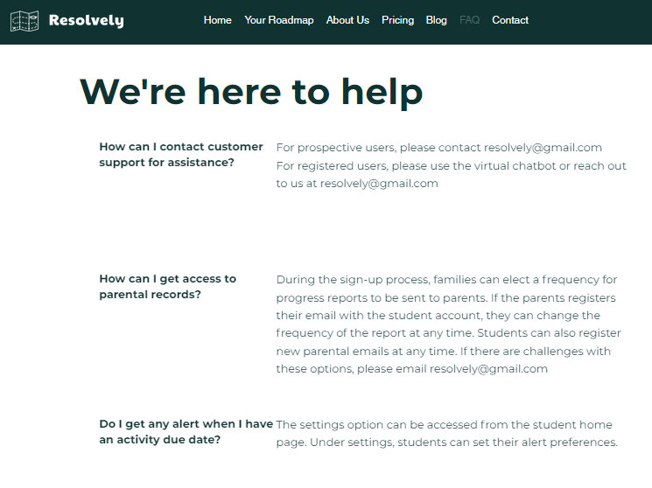
Current State of Resolvely FAQ

Slide 5
Agenda
FAQ - Current State
FAQ – Future State / Inspiration
Checklist of FAQ Design
Code to See – UseState, Accordion Toggle, Filtering
Code to Consider – Recommendation
Conclusion

Slide 6
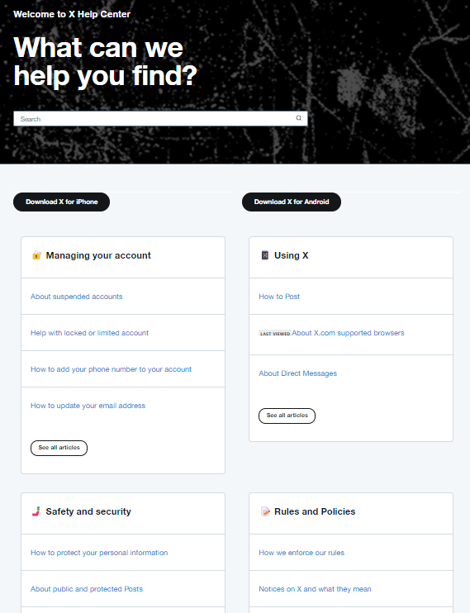
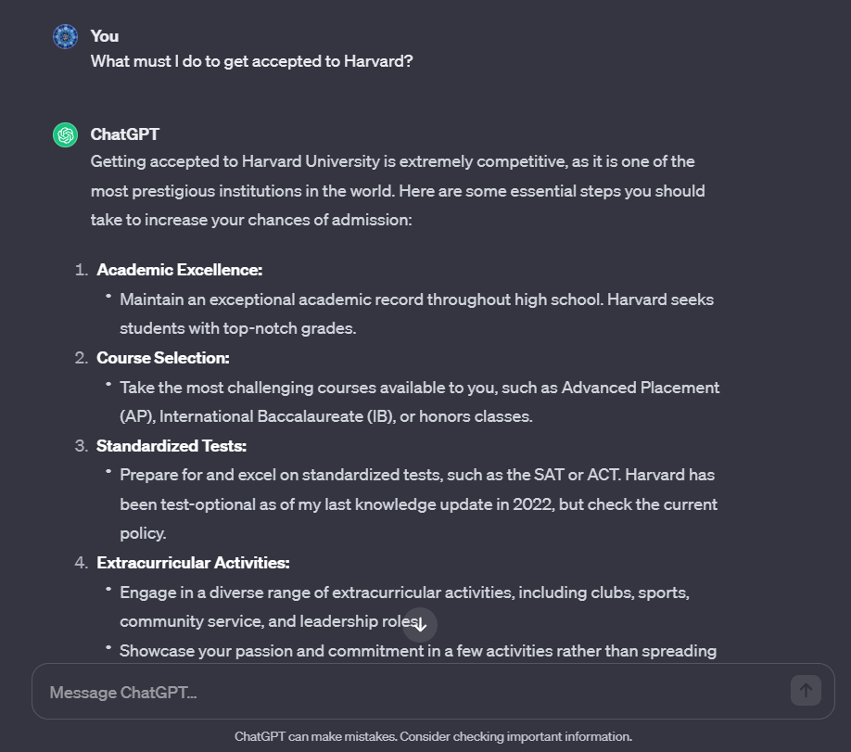
Future State – aka Inspiration

Slide 7
Agenda
FAQ - Current State
FAQ – Future State / Inspiration
Checklist of FAQ Design
Code to See – UseState, Accordion Toggle, Filtering
Code to Consider – Recommendation
Conclusion

Slide 8
FAQ Design Checklist
Backend Functionality:
Content Management: The backend includes a content management system (CMS) for adding, editing, and updating FAQ entries. Authorized administrators can make changes as needed.
Database Management: FAQs and related data are stored in a database, allowing for efficient retrieval and management of the content.
Authentication and Authorization: User roles and permissions are defined to ensure that only authorized personnel can manage and update FAQ content.
Analytics and Reporting: The backend may include analytics tools to track user interactions with the FAQs. This data can help administrators understand which questions are most commonly accessed and identify areas where additional content or improvements are needed.
Integration: The backend may be integrated with other systems, such as customer support tools or chatbots, to provide a seamless user experience and ensure consistent answers across channels.
Version Control: A version control system helps track changes to FAQs, allowing administrators to revert to previous versions if necessary and maintain a history of updates.
Security: Robust security measures are implemented to protect the FAQ system from unauthorized access, data breaches, and other security threats.
Scalability: The system is designed to handle a growing database of FAQs and an increasing number of users without compromising performance.
Backup and Recovery: Regular data backups and a disaster recovery plan are in place to prevent data loss and ensure the availability of FAQ content.
APIs and Integration: The FAQ system may offer APIs (Application Programming Interfaces) to allow integration with other applications or websites.
Frontend Functionality:
User-Friendly Interface: The frontend provides a user-friendly interface for visitors to access and interact with the FAQs. It includes a clean and responsive design that works well on various devices.
Search Functionality: Users can easily search for specific questions or topics within the FAQ database. A search bar allows for quick access to relevant information.
Categorization: FAQs are organized into categories or topics, making it easier for users to navigate and find answers related to their specific interests or needs.
Sorting and Filtering: Users can sort and filter FAQs based on criteria such as relevance, popularity, date, or category. This helps users quickly find the most relevant information.
Readability: FAQs are presented in a clear and easily readable format. They may include text, images, and links for more detailed explanations or related resources.
Interactive Features: Some FAQ systems incorporate interactive elements, such as collapsible sections or buttons for expanding answers, enhancing the user experience.
Feedback Mechanism: Users can provide feedback on the usefulness of FAQ answers, helping improve the quality and relevance of the content over time.
Required and Complete
Not Required
Required and Not Yet Started
Mission Essential Issues
Required, Started and has issues

Slide 9
Agenda
FAQ - Current State
FAQ – Future State / Inspiration
Checklist of FAQ Design
Code to See – UseState, Accordion Toggle, Filtering
Code to Consider – Recommendation
Conclusion

Slide 10
Code to See
Interactive Features:
  React useState x 3:
  activeIndex, setActiveIndex for Accordion
  allContents, setAllContents to hold returned db object
  filteredContents, setFilteredContents to hold filtered db objects to render
  Bootstrap: Accordion Container
  Accordion Item
  Accordion Header
  Accordion Button
  Accordion Collapse
  Accordion Body
  JavaScript toggleAccordion function
Categorization:
JavaScript filterByCategory function
Sorting and Filtering:
Buttons call filterByCategory with unique categoryId

Slide 11
Code to See
[
{
"id": 0
,“question": "How does Resolvely's pricing work?"
,“answer": "Resolvely subscriptions allow coaching teams of up to 5 people, including the student. The price of a paid Resolvely plan is tiered, starting in groups of 5 and 10 users, based on the number of people you have in your Team or Organization."
,“category":
{ “id” 2,
“name” : "Account“
}
,“sortOrder": 1
},
{
"id": 1
,"Question": "What forms of payment do you accept?"
,"Answer": "You can subscribe to Resolvely with any major credit card. For annual subscriptions, we can issue an invoice payable by bank transfer or check. Please contact us to arrange an invoice purchase. Monthly purchases must be paid for by credit card."
,“category":
{ “id” 2,
“name” : "Account“
}
,"SortOrder": 1
},
]

Slide 12
Agenda
FAQ - Current State
FAQ – Future State / Inspiration
Checklist of FAQ Design
Code to See – UseState, Accordion Toggle, Filtering
Code to Consider – Recommendation
Conclusion

Slide 13
Code to Consider
Interface
External
API Integration??
Client
Database
Controller
Services
Frontend Files:
Function Specific
FaqAccordion.jsx
faqService.js
FaqAdd.jsx
Edited Supporting / Adjacent
App.jsx
publicRoutes.js
PageHeader.js
Suspected / Adjacent
Index.html, App.css
Index.js, serviceHelper.js
Assets for PageHeader.jsx
AND OTHERS!
Dependency Injection
Model
Domain
Requests
Notes:
# Connectiong to DB with .Net
You should use the Console application in this project (Open Sabio.Db.ConsoleApp.sln)
and write code using the included projects to call all the procs in the `/SqlInit/Sabio_Address.sql` file.
The instructors will help you with the first couple of procs and then you finish the rest on your own using the resources available to you.
> :star: Be sure to get instructor help to run the `/SqlInit/Sabio_Address.sql` file.
Use the following Page to help you.
- [Working .Net Services Classes](https://github.com/sabiocode/wiki/blob/master/dotnet/data-access/service-class.md)
- [Data Service CRUD Operations Videos](https://training.sabio.la/courses/516025/lectures/10839166) to go with Data Access via Service Classes
- [How to Use DataProvider (ExecuteCmd)](https://github.com/sabiocode/wiki/blob/master/dotnet/data-access/DataProvider/DataProvider-ExecuteCmd.md)
- [How to Use DataProvider (ExecuteNonQuery)](https://github.com/sabiocode/wiki/blob/master/dotnet/data-access/DataProvider/DataProvider-ExecuteNonQuery.md)
---
# Background on Models
## Models
Models serve to carry data from one place to an other.
In many applications, Models are used in a variety of ways including partial updates, inserts and deletes.
In our application we will create a more refined architecture and create 4 different types of Models.
These four types will be named according to their utility or purpose
### Request Models
- These models will be used to pass data into a Controller or Service method
- These models will participate in Model Binding where data from an incoming request will be mapped to the properties of the given Model.
- They will be used to perform updates, inserts or deletes. More often than not, they will contain partial list of all the properties of the entities that they represent.
> Located in `Sabio.Models.Requests`
> :key: They are **PASSED* into Service Method calls or Controller Methods
### Response Models
- These Models will be the objects passed **out** of Api Controllers.
- Often times these Models will be used to wrap Domain models as they are passed out of the web application.
- All Response Models must inherit from BaseResponse.
> Located in `Sabio.Models.Responses`
> :key: They are returned from Controllers
### Domain Models
- These models will be used to most accurately represent the entities we store in our database.
- When returned, they should be fully hydrated with the data in the database.
- These files are located here at the following path. You should inspect the files there for more information.
> Located in `Sabio.Models.Domain`
> :key: They are returned from Service Method calls

Slide 14
Code to Consider
PUT API call to ChatGPT with this Payload Object:
CHATGPT ANSWER via JSON Response Object
{
"id": "chatcmpl-6p9XYPYSTTRi0xEviKjjilqrWU2Ve",
"object": "chat. Completion",
"created": 1677649420,
"model": "gpt-3.5-turbo",
"usage": {
"prompt tokens": 4,
"completion tokens": 41,
"total tokens": 45
}, "choices": [
{
"message": {
"role": "assistant",
"content": “Getting accepted to Harvard University is extremely competitive, as it is one of the most prestigious institutions in the world. Here are some essential steps you should take to increase your chances of admission:
1. Academic Excellence:
* Maintain an exceptional academic record throughout high school. Harvard seeks students with top-notch grades.
2. Course Selection:
* Take the most challenging courses available to you, such as Advanced Placement (AP), International Baccalaureate (IB), or honors classes….. (….followed by 16 more steps)
},
"finish reason": "stop",
"index": 0 } ]}
QUESTION via JSON Request Object
{
"messages": [
{
"role": "system",
"content": "You are a helpful assistant"
},
{
"role": "user",
"content": “What must I do to get into Harvard?"
}
]
}

Slide 15
Agenda
FAQ - Current State
FAQ – Future State / Inspiration
Checklist of FAQ Design
Code to See – UseState, Accordion Toggle, Filtering
Code to Consider – Recommendation
Conclusion

Slide 16
Conclusion
Coding Concepts Illustrated
  React useState to implement state to control accordion, hold database values, hold filtered values to display
  JavaScript Filter
  JavaScript Map
Design objectives are key and may be mission essential. Watch Resolvely for the ai in Resolvely.ai.
Accessing Advanced AI appears to be as easy as sending and receiving API payloads. Display to user should be straight forward. The trick will be in middle tier to store FAQs, manage token expense, and ensure safety and security of minors.

Slide 17
Questions

